Slide 1

Space Map game

Slide 2
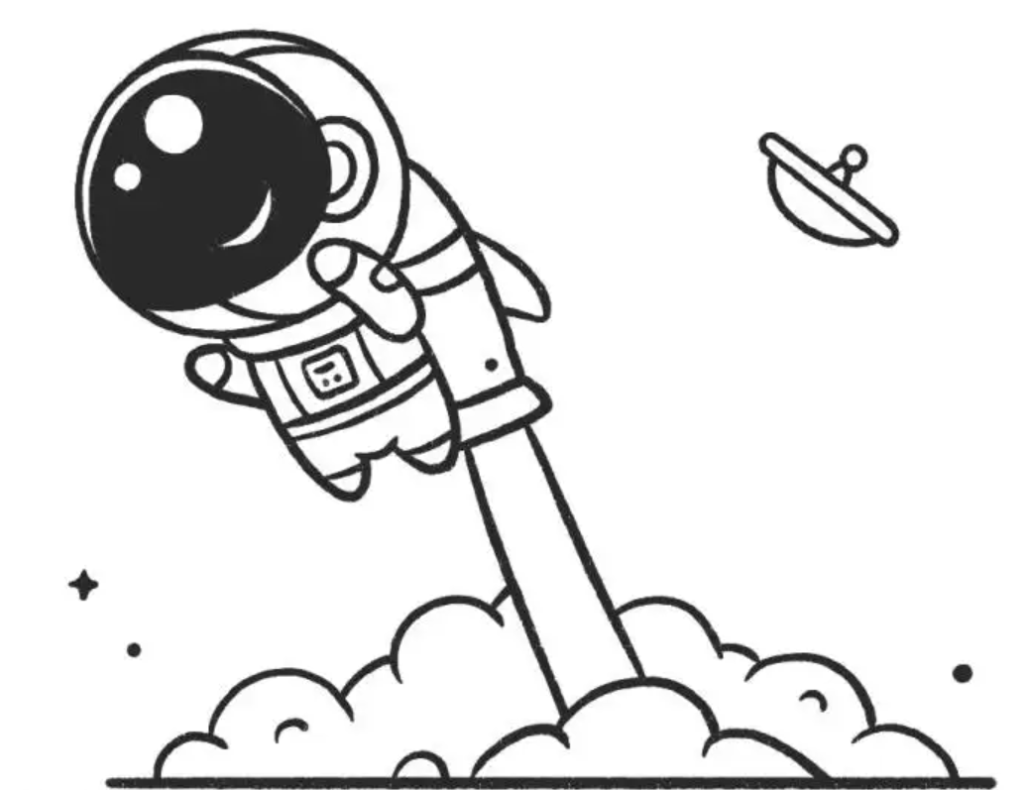
Team Members
Sai Krishna Chillara
Rafael Cordero
Daishik Kaushik Ghatalia
William Hollingsworth
Yuanjun Jin
Woobae Kim
Sai Pavan Malisetty
Vamsi Kiran Reddy Muddam Shankar
Harpreet Singh
Tianyi Wang

Slide 3
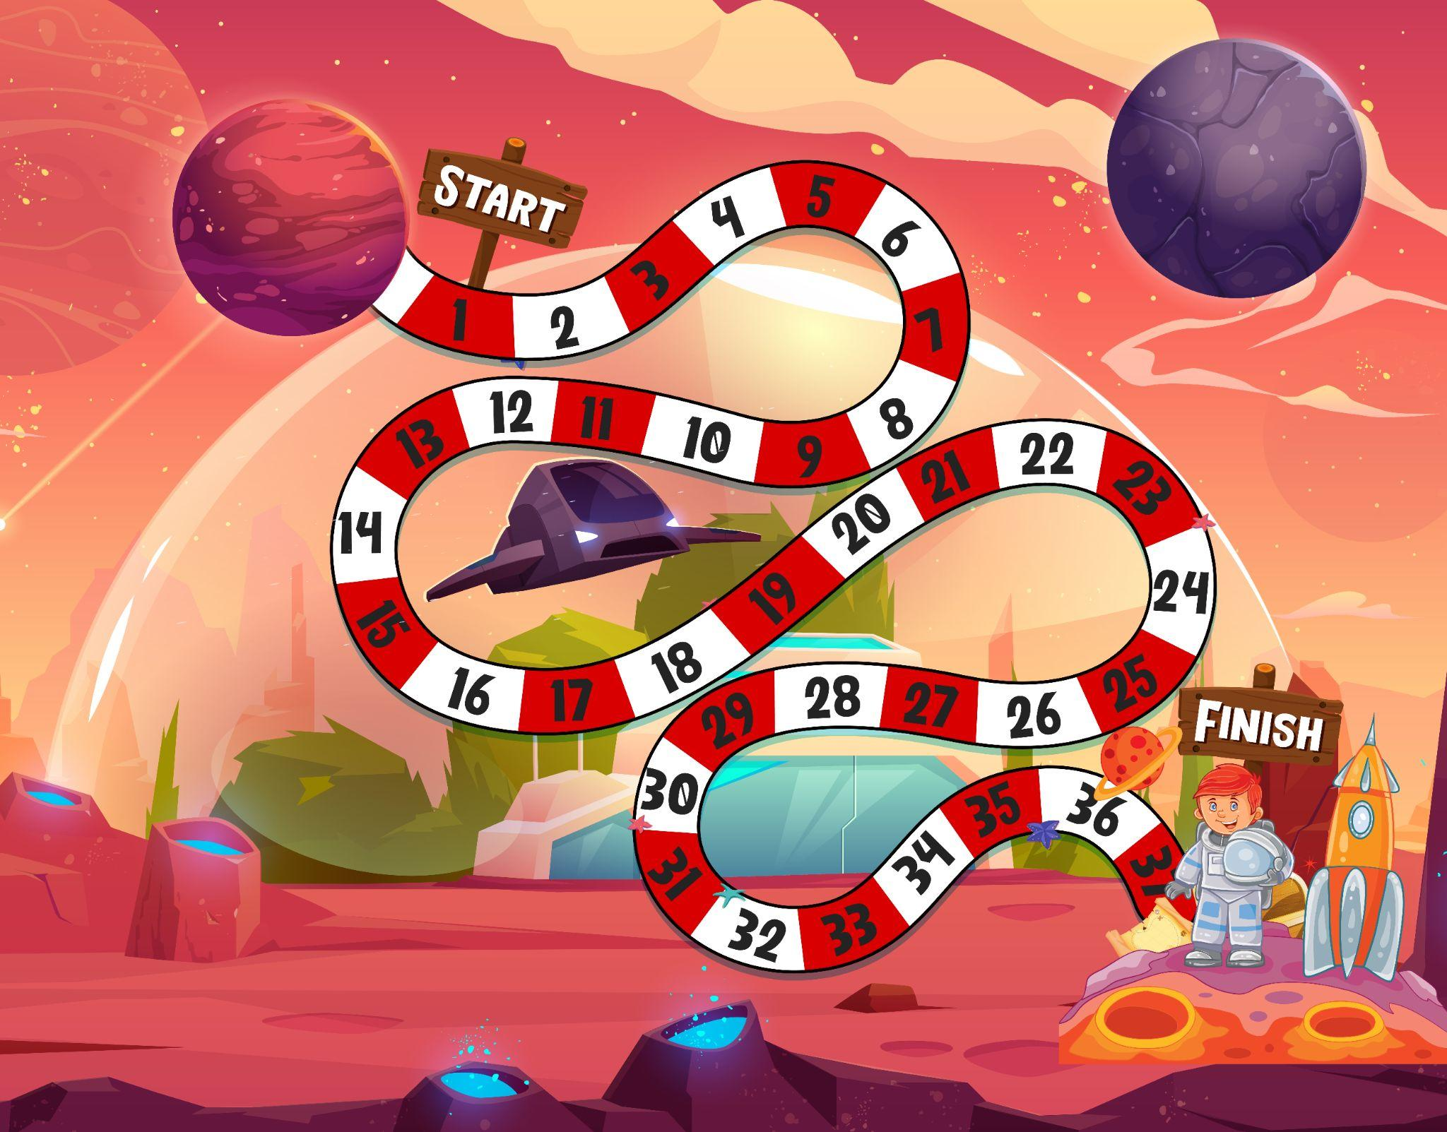
Game Interface

Slide 4
Requirements
1. 1-6 die roll
2. 9+ different cards
3. Every other node is the hotspot where the card is being drawn
4. Bidirectional
5. The game ends when everyone reached the finish line
6. Points are awarded for finishing first
7. Points are awarded for how many players are behind you
Notes:
Tianyi Wang

Slide 5
Game Introduction
1.use Graph and/or Digraph data types
a.https://algs4.cs.princeton.edu/41graph/
b.https://algs4.cs.princeton.edu/42digraph/
2.Read in a node table from a text file
3.Game has at least 36 spaces. 0-35 We use the adjacency-lists representation, where we maintain a vertex-indexed array of lists of the vertices connected by an edge to each vertex.
4.Must have at least 9 different traps and or bonuses. 9 different cards that randomly draw on the hotspot
5.Must use both bi-directional and directional paths
6.Must allow 1-4 players
7.Must automatically play the game (no decision points for players)
Notes:
Jun

Slide 6
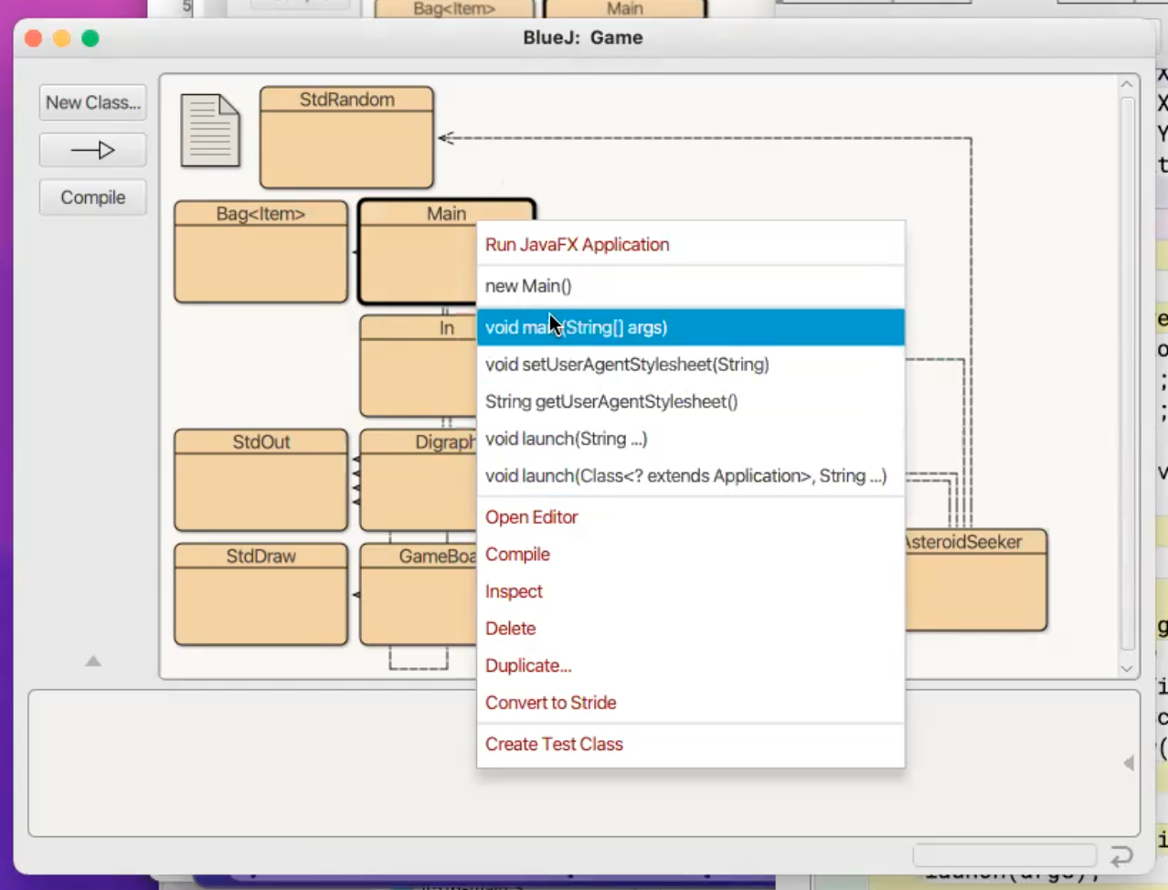
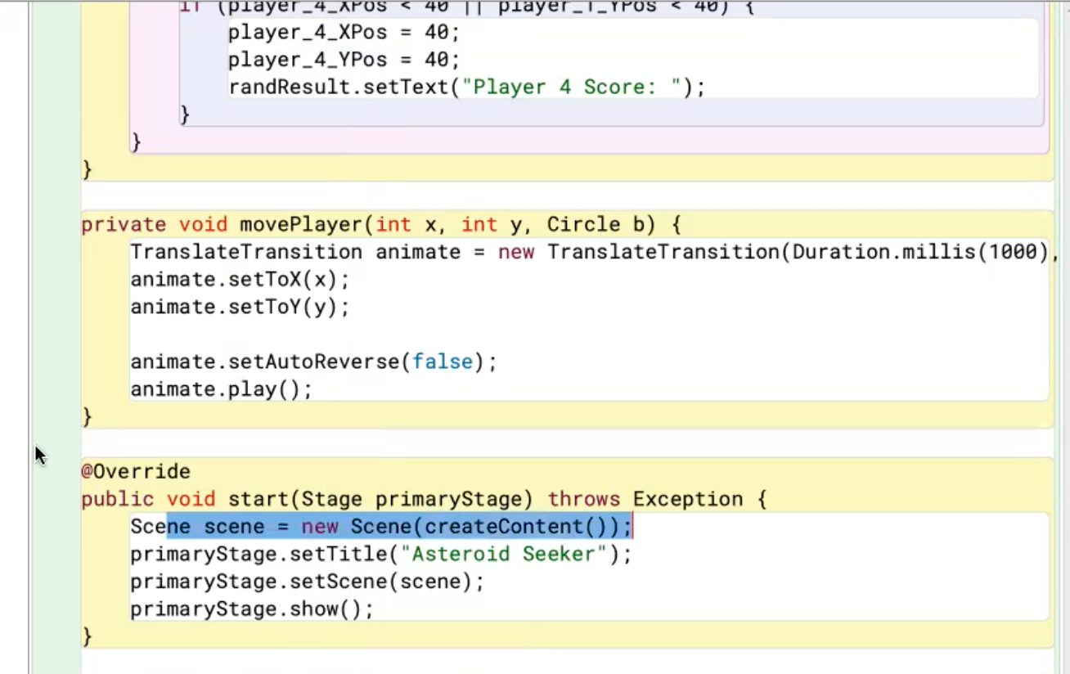
MainClass.java
Program runs from the main
From the main we can execute it using the main method
Main method is going to launch the program, which is going to build the scene

Slide 7
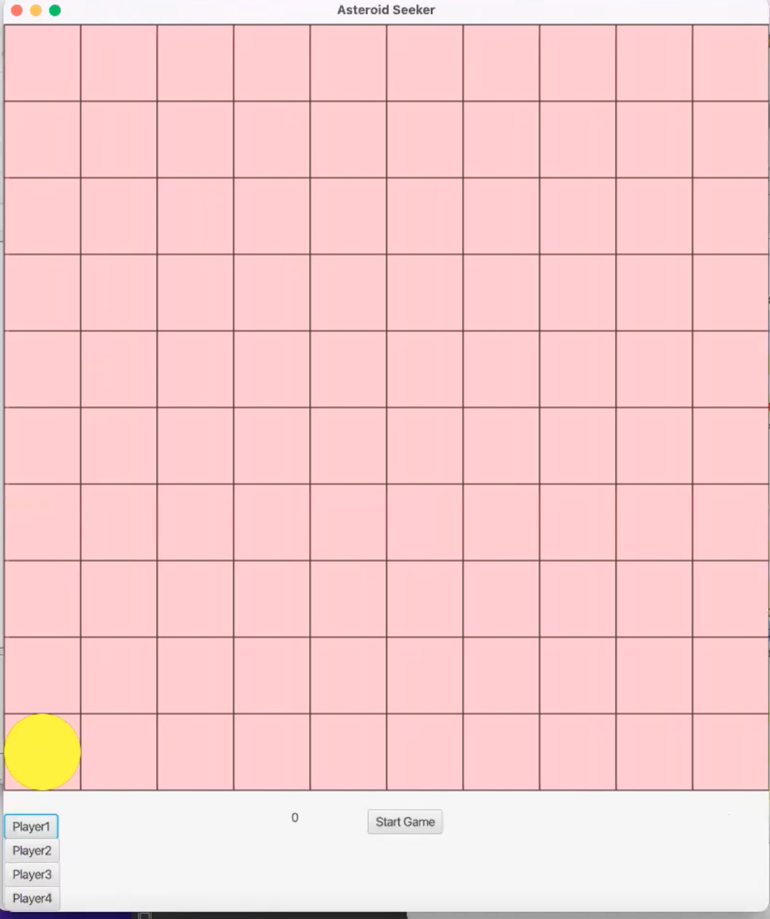
Here is the initial setup of the game
All this happened in the create content section
We only see one color on the board right now because all the circles are stacked on top of each other

Slide 8
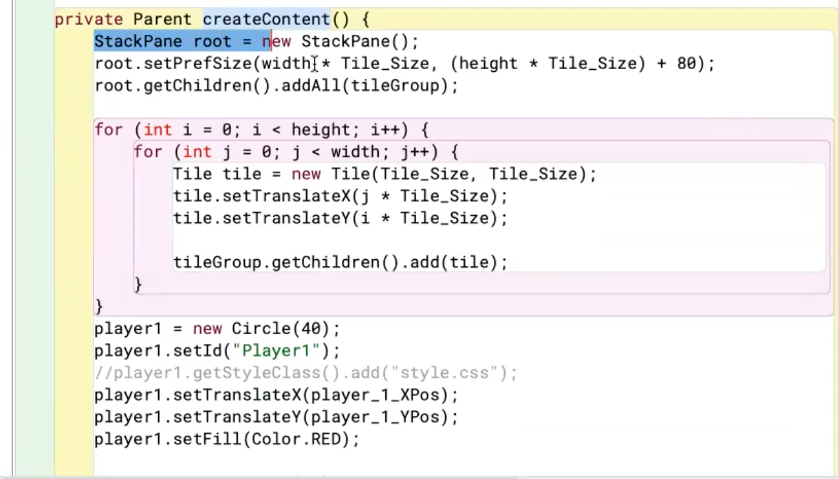
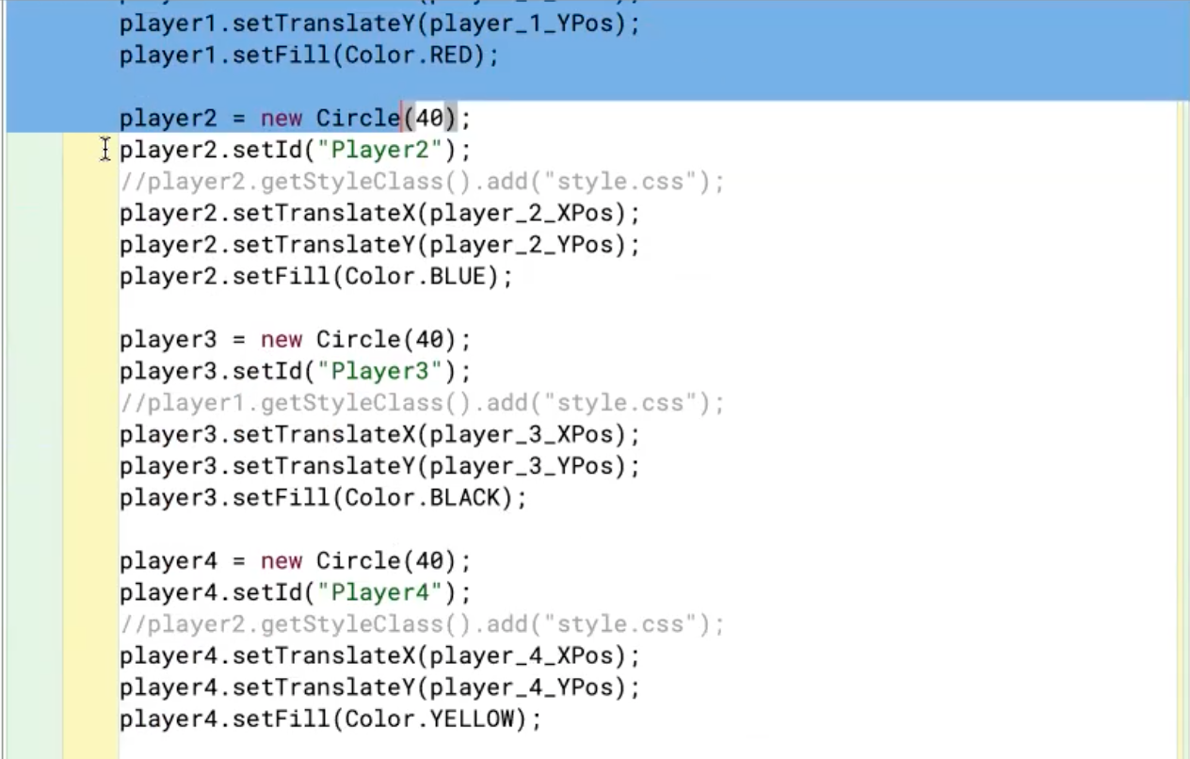
Rootpane = creating the whole window
Setting the size
Creating all the tiles
Creating all the players

Slide 9
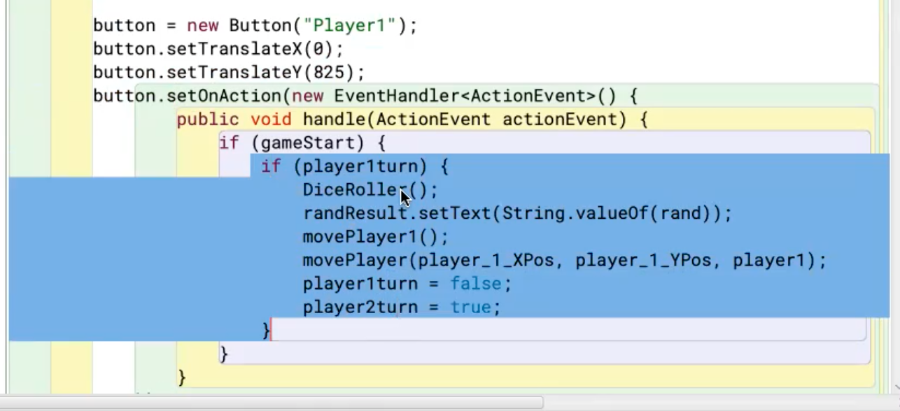
Here is where we set up the clickable buttons
When each button is clicked, it’s going to run this chunk of code where it rolls a die and moves the player.
Game has to start in order to start clicking on the players’ buttons

Slide 10
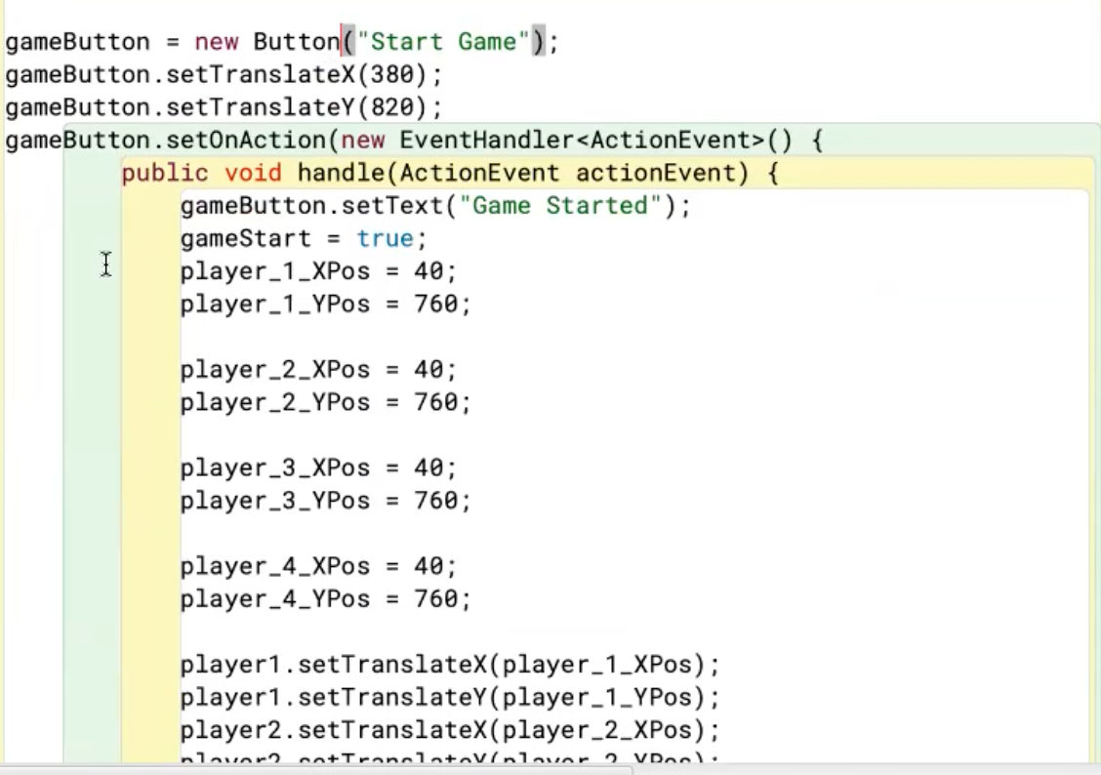
Game Start Button
The game start button will reset all the positions
This won’t do anything the first time but if you want to reset and play it the second time, it will reset all the positions

Slide 11
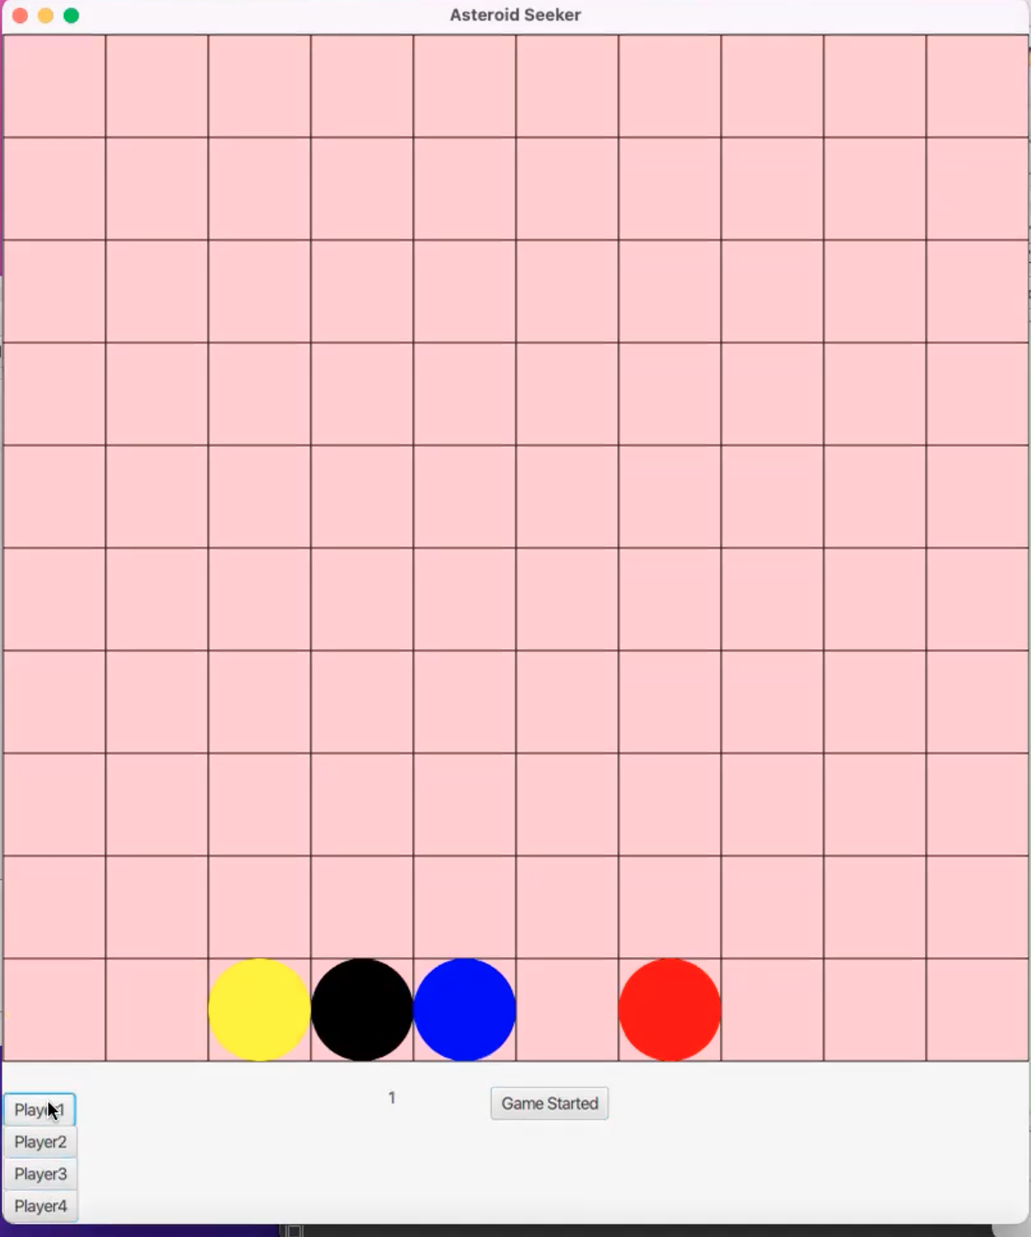
We will run DiceRoller(), which will pick a random dice roll
randResult.setText(String.valueOf(rand)) = shows the number we rolled
We will call movePlayer1() to see where Player 1 ends up
The movePlayer() function is the animation (We have the target X position and target Y position for the player and player 1 is the red circle because we color coded it red)
And (player1turn = false; player2turn = true) just indicates that player1’s turn is over and that it’s player2’s turn
The flow of the game is that once a player reaches the top of the board, we get a winner and the game is over.

Slide 12
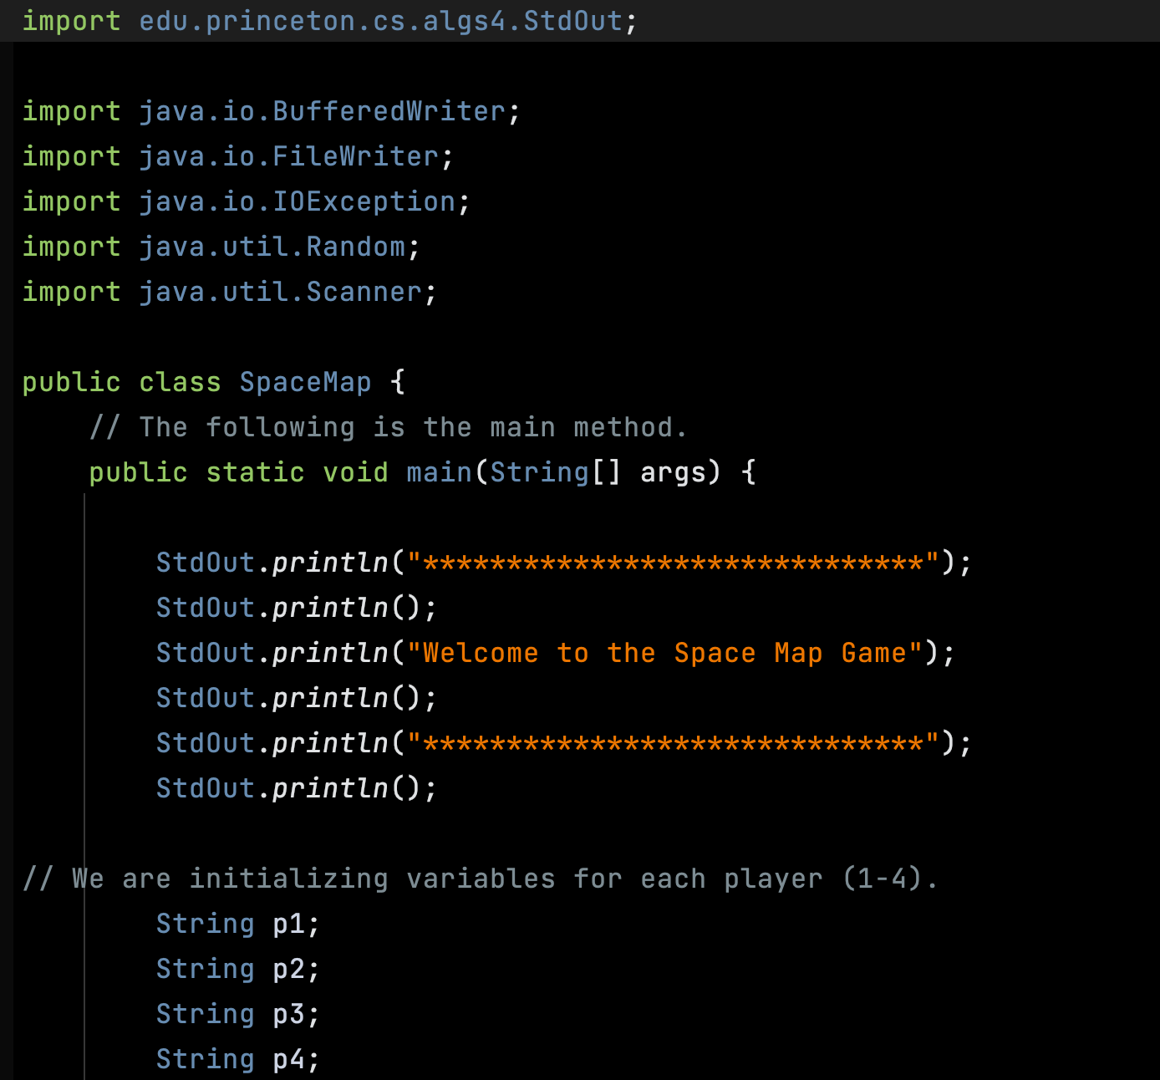
SpaceMap.java
Declare our classes
Print out the message
Notes:
Rafael

Slide 13
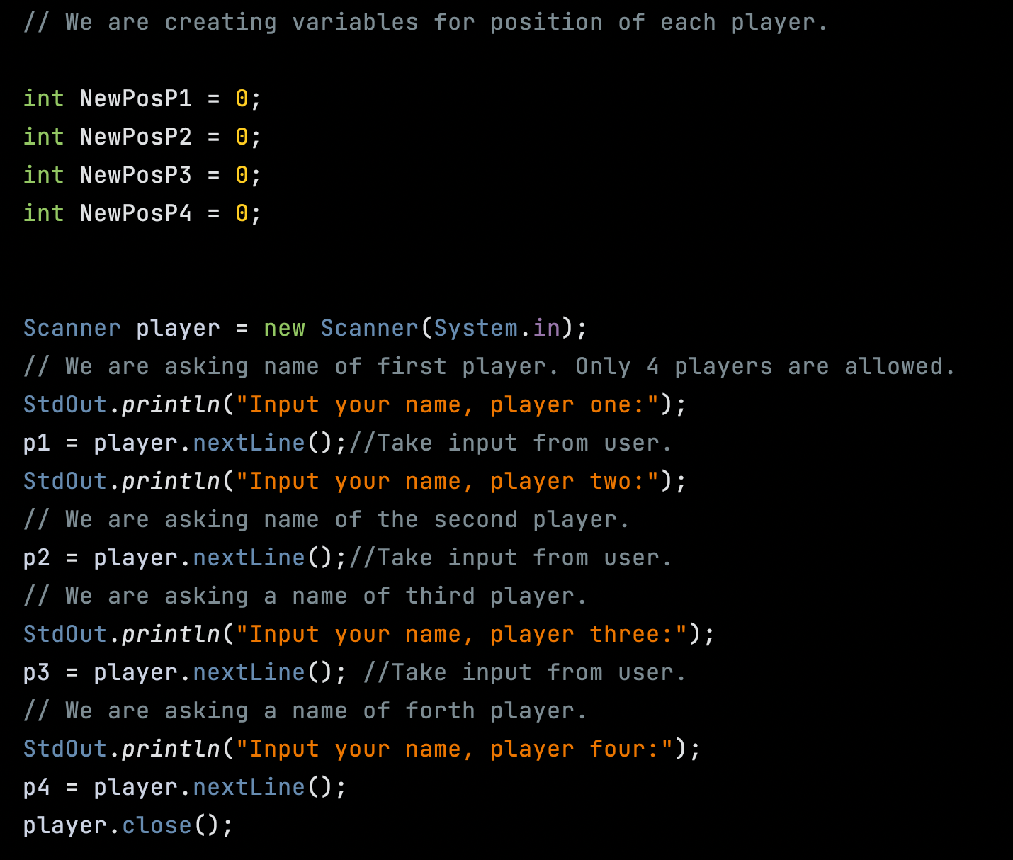
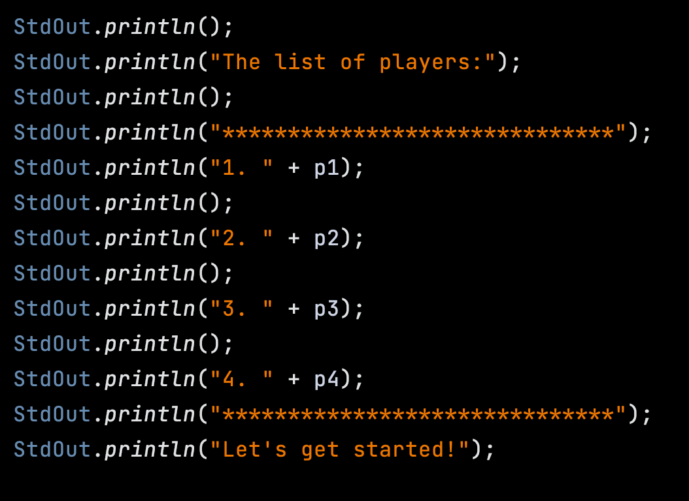
Scanner
Read input from the input stream:
Scanner sc1 = new Scanner(InputStream input);
To create an object of Scanner class, we usually pass the predefined object System.in, which represents the standard input stream.
read input from files
Scanner sc2 = new Scanner(File file);
Notes:
Rafa

Slide 14
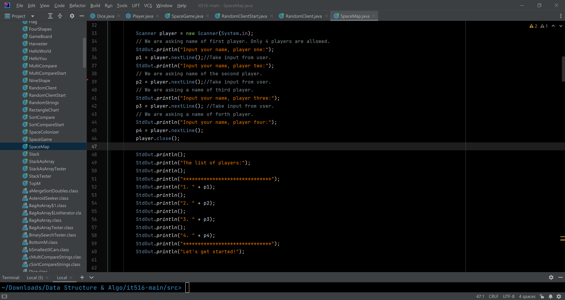
TitleClass.txt
Notes:
Cole
*Taking the name from the user
*And we are printing it

Slide 15
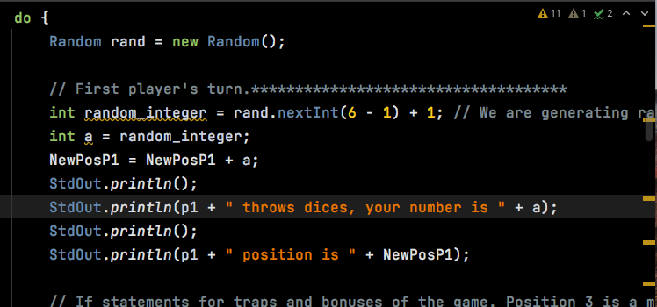
DO - First Player turn
Notes:
Vamsi

Slide 16
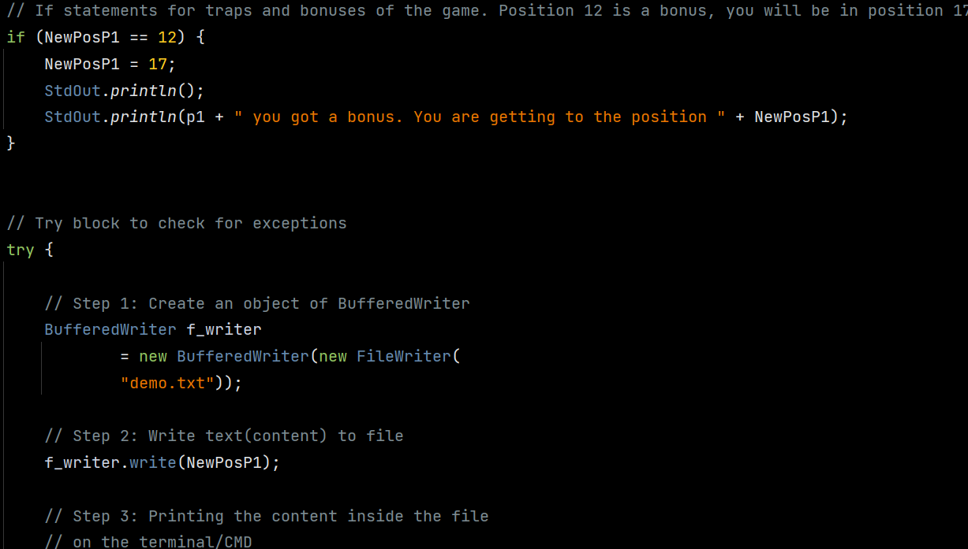
Position changes
Notes:
Harpreet Singh

Slide 17
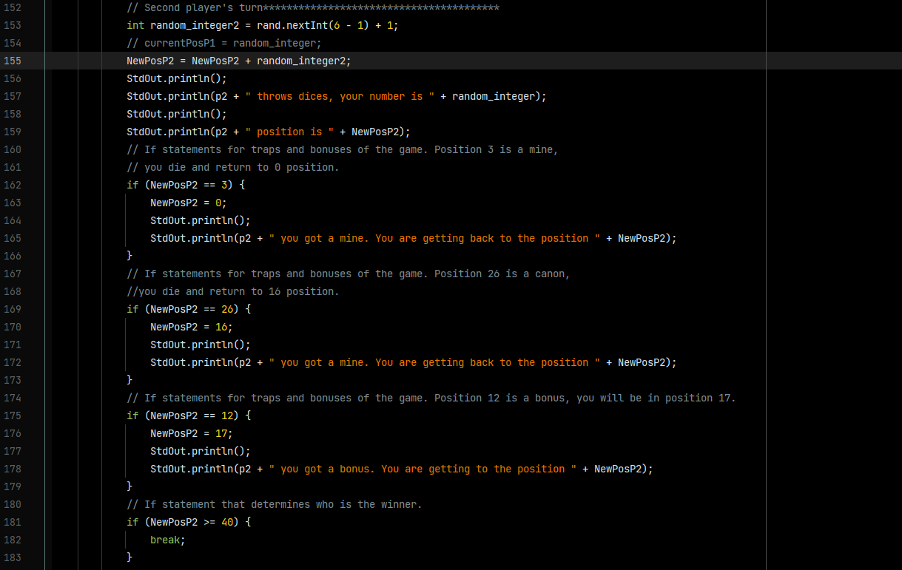
Traps and bonuses (Player 2)
Notes:
Sai Krishna Karthik

Slide 18
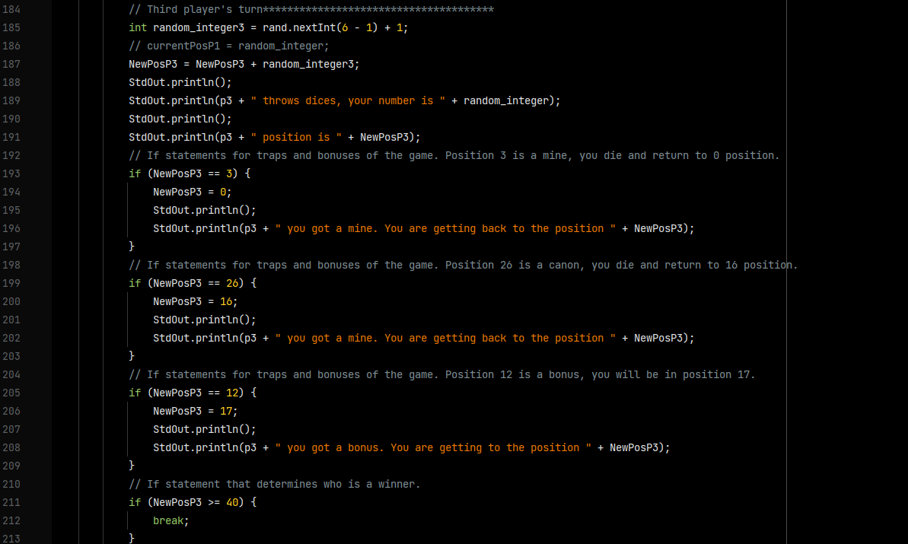
Traps and bonuses(Player 3)
Notes:
Sai Krishna Karthik

Slide 19
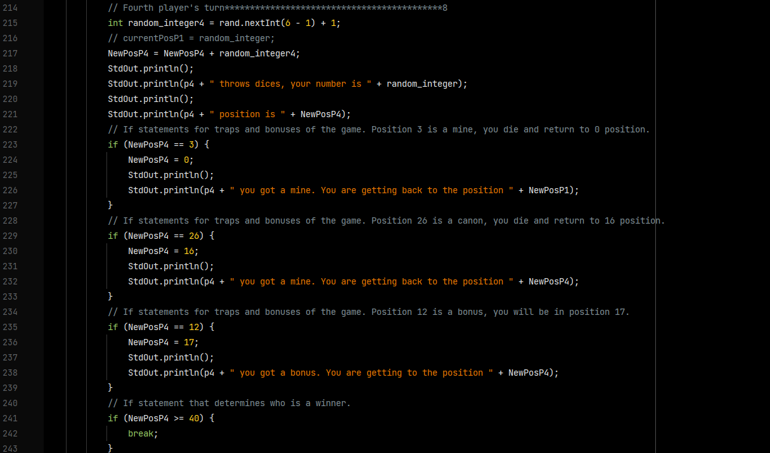
Traps and bonuses (Player 4)
Notes:
Sai Pavan

Slide 20
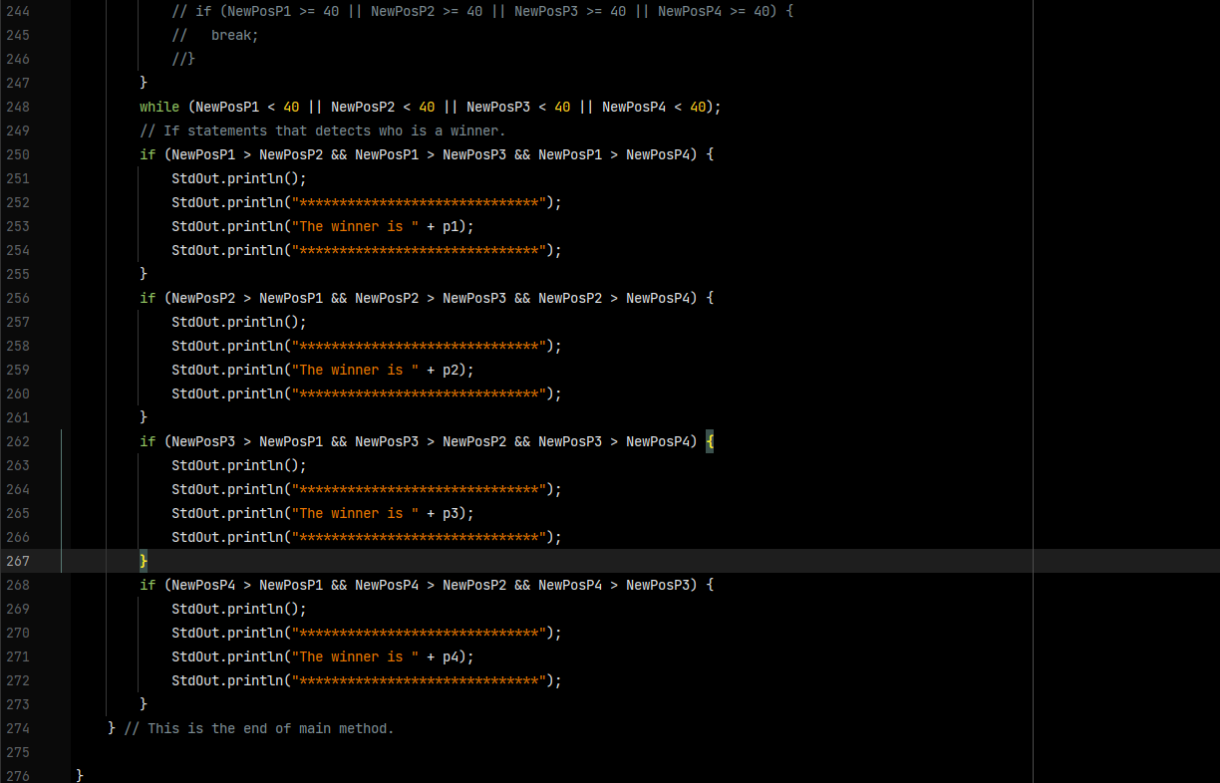
winner
Notes:
Sai Pavan

